Slide 1
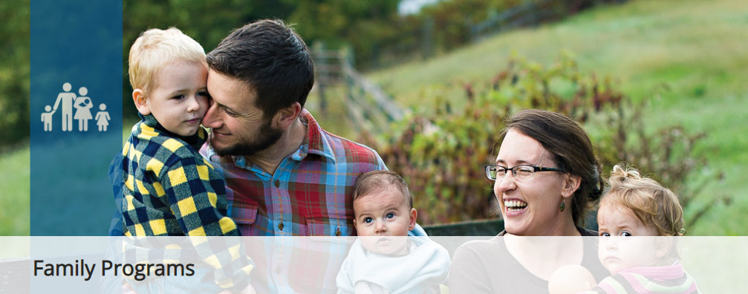
F
A
M
I
L
Y
By: Mario Duguay
P r o g r a m s

Slide 2
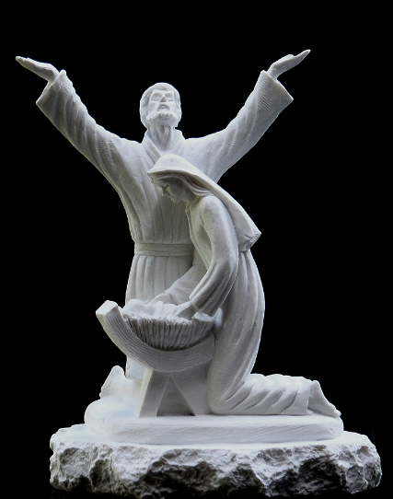
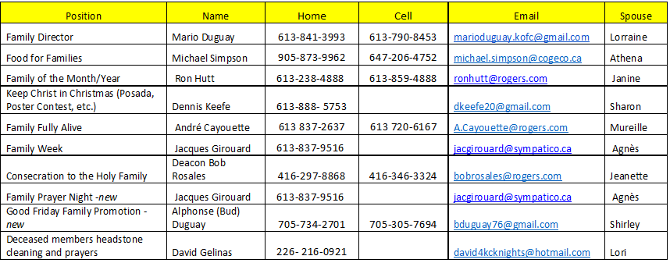
C
H
A
I
R
M
E
N
C O N T A C T

Slide 3
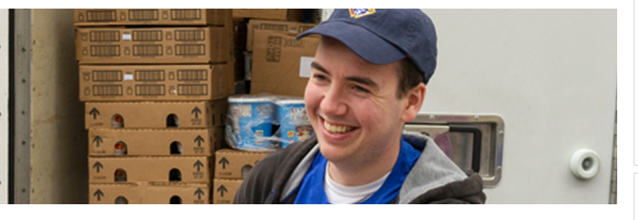
Featured Program
F
O
O
D
F
O
R
Councils are required to collect a minimum of $500 or 1,000 pounds of food for a parish or community food pantry. In addition, council must contribute a minimum of 100 total man-hours in preparation/distribution/ service of meals.
Report activity using the Food for Families Refund and Plaque Application (#10057).
This year we want every District to have at least one new council participate in this program to increase participation by 30%.
F A M I L I E S

Slide 4
F
A
M
I
L
Y
Local councils establishes a committee to recognize a deserving Family of the Month and Family of the Year with potential for recognition on the international level.
Each month, the council Family of the Month committee selects one parish family that models Christian family values and visibly lives them every day.
Once a year, each participating council also selects one of the previous twelve Family of the Month winners to represent the council/parish as the potential international Family of the Year.
Of the Month / Year

Slide 5
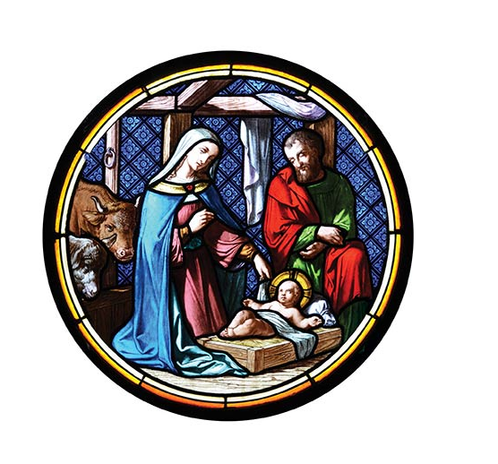
Keep Christ in Christmas
C
H
R
I
S
T
M
A
S
The new Keep Christ in Christmas program encourages councils to compel their neighbors to shift from a preoccupation with materialism to the light of Christ and the spirit of giving. Activities include whatever efforts best suit the parish and community of a particular council and do not need to originate from the Knights of Columbus Supreme Council.
POSTER CONTEST

Slide 6
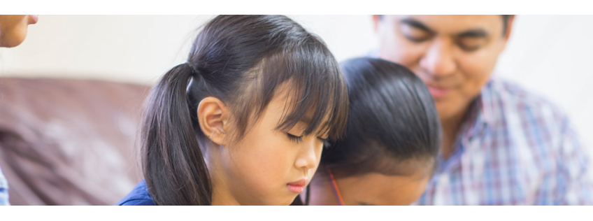
F
A
M
I
L
Y
Using the Family Fully Alive Booklet as a devotional guide, the Family Fully Alive program provides monthly themes, reflections, meditations and group projects for you and your family.
Working with your pastor, obtain his permission and recommendations on promoting Family Fully Alive in your parish and community.
Order a good quantity of Family Fully Alive Booklets (#10162) through Supplies Online.
F U L L Y A L I V E

Slide 7
A Rose for Our love One
F
A
M
I
L
Y
Dedicate a week to celebrate our families. Councils should plan a special week for their parish celebrating family life.
On the Sunday of Family Week Councils are to select one hospital in their community and distribute one single rose to all patients and staff.
Include a little note on the rose with a message of hope and the name of your council. Organize a mass in the hospital chapel for anyone to attend.
Have the Brother Knights and their family distribute the rose or ask your parishioners to participate.
W E E K

Slide 8
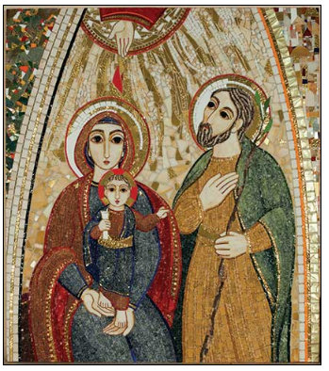
C
O
N
S
A Higher Purpose
Help strengthen families and revitalize our parishes. Knights of Columbus councils will invite each family in their parish to consecrate themselves to the Holy Family and to devote themselves to the ideal model of familial love set by Jesus, Mary and Joseph.
Overview.
Supreme Chaplain Archbishop William E. Lori has composed a prayer through which families will come together and pray.
Councils will lead their Parishes and community to understand and offer this important and impactful prayer.
E
C
R
A
T
I
O
N
To the Holy Family….

Slide 9
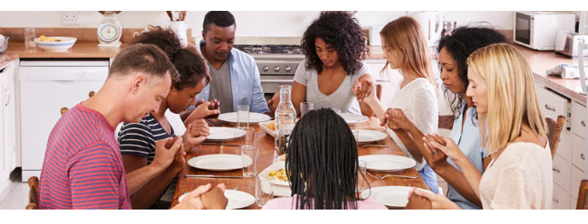
F
A
M
I
L
Y
A Higher Purpose
Strengthen the bonds within our parishes and build faith-filled families. This is an opportunity for council members, families and the whole parish community to come together once a month for an evening of prayer, dinner and fellowship.
Overview
Family Prayer Night is an opportunity for children to be exposed to regular people living their faith in a casual setting. Families of council members, as well as other Catholic families within the parish and community, will gather for prayer, dinner and fellowship. Multiple groups can be formed and families are encouraged to rotate between these groups.
P R A Y E R N I G H T

Slide 10
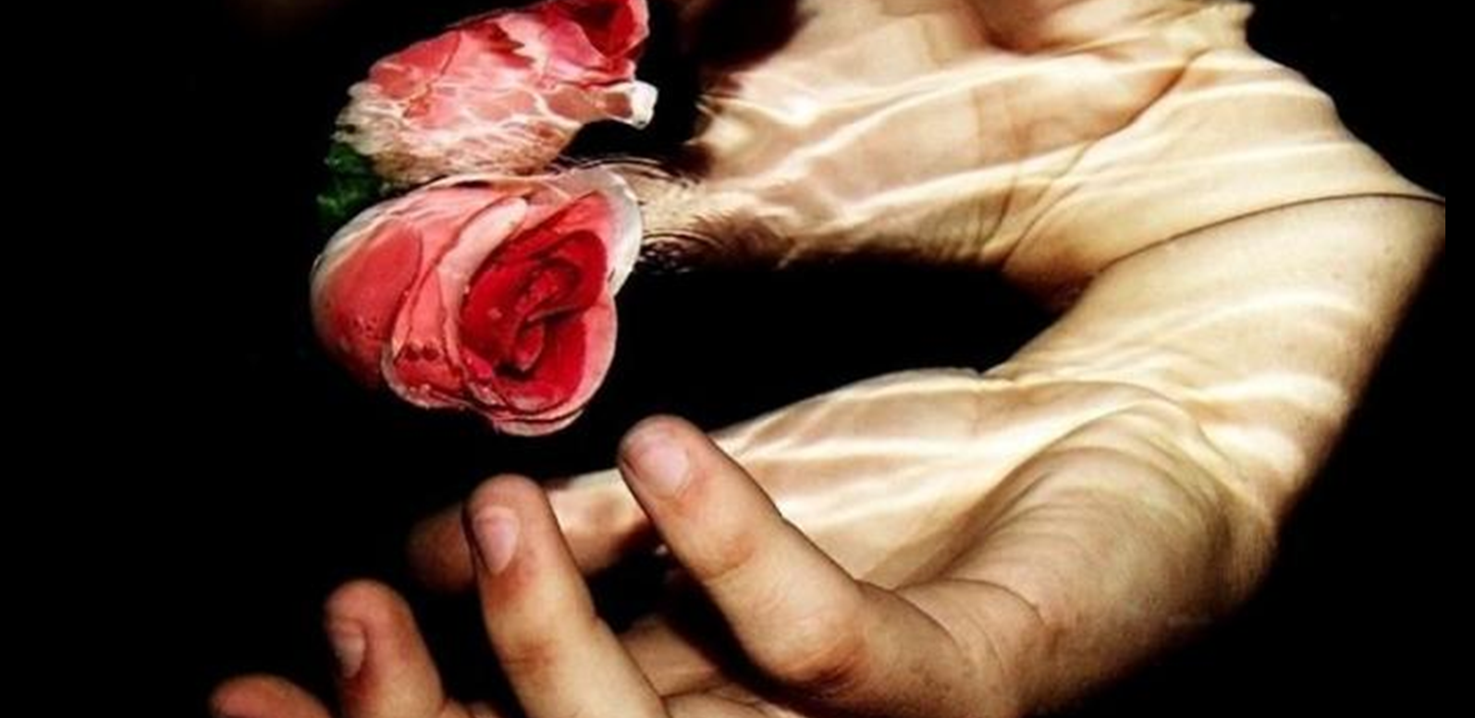
G
Councils will encourage participation in Good Friday services through a promotional campaign.
O
O
D
F
R
I
D
A
Y
FAMILY PROMOTION

Slide 11
Why: To recognize, pay tribute and pray for the repose of souls of our deceased members and to bring aid and support to our widows
How: To annually clean the headstones of our deceased members and pray for the repose of their souls. Together you recite “Lord’s prayer” in memory of deceased member. Invite widow or family member to place KC flag at head stone.
When: Anytime it is convenient for the council.
Who: Council members, Squires and parish community
Where: Local cemetery
H
E
A
D
S
T
O
N
E
CLEAN-UP

